Slide 1


Altis Academia – 96bulls
Individual portfolio

Slide 2
Individual contribution
Taken Team Leader Role
Checked the progress of team
Kept team on track on our planned scope
Became bridge for developers and non developers and linked them
Distributed equal works to each team members
Front-end and Back-end Software Development
Created main react-firebase app
Created basic pages, such as QUIZ
Worked on designing with CSS
Worked on sign-in, sign-out, register system
Worked on anonymous Chat room

Slide 3
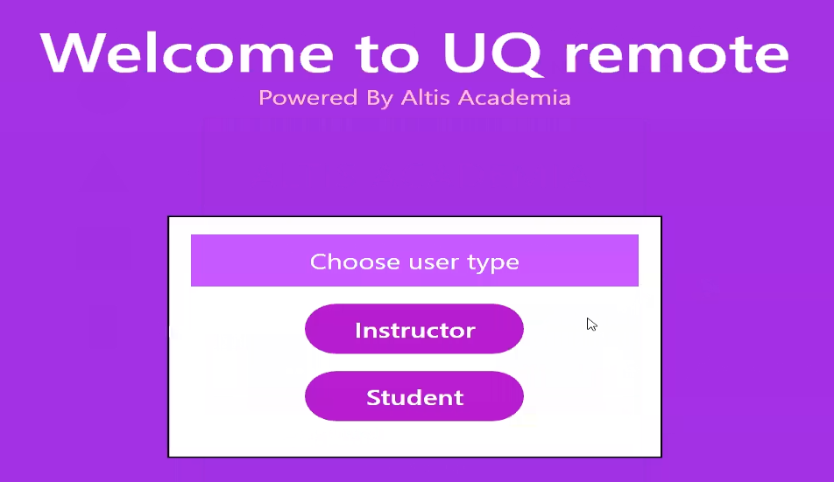
Individual development – Main page

Slide 4
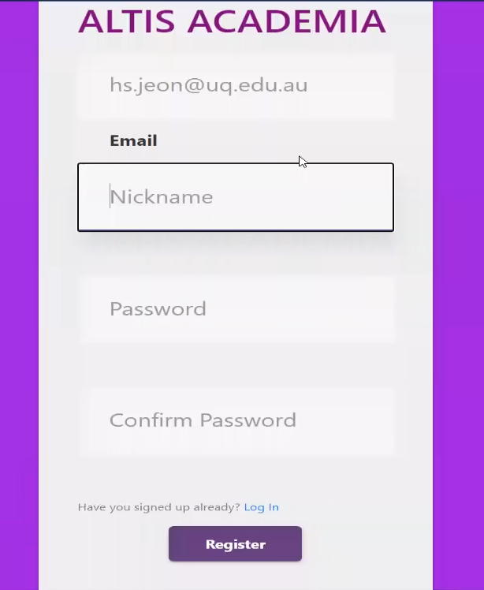
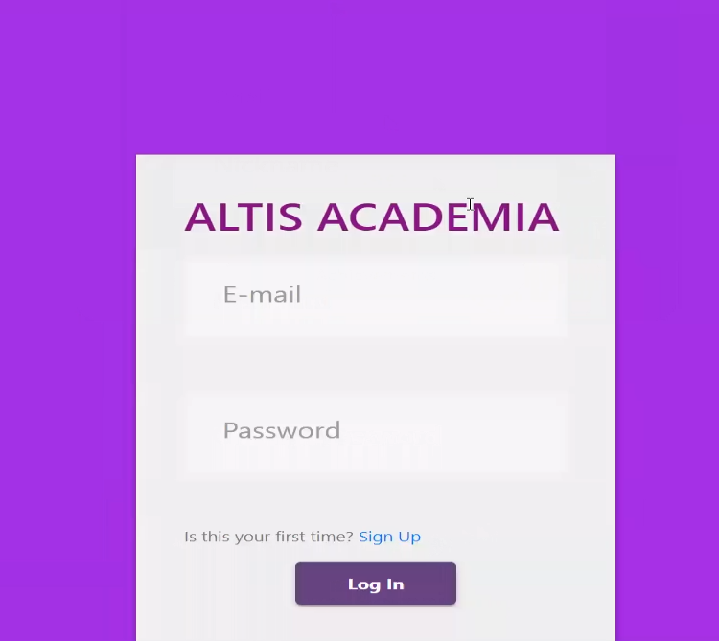
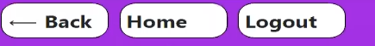
Individual development – register/login/logout

Slide 5
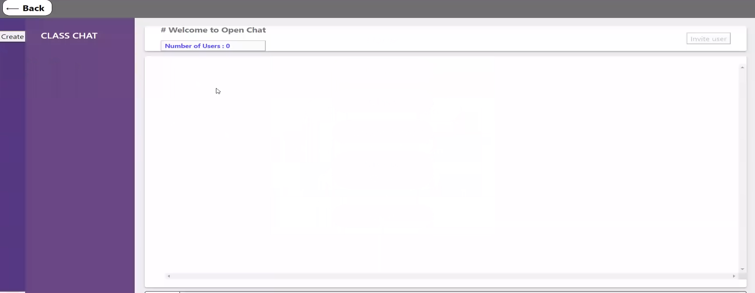
Individual development – Chat

Slide 6
Collaboration
Used Github as our main repository
Everyone worked on their branch and communicated before anyone merged
Reduced merge conflicts
Used Facebook Chat as main discussion chatting
Used Discord Channel as main announcement and progress report chatting

Slide 7
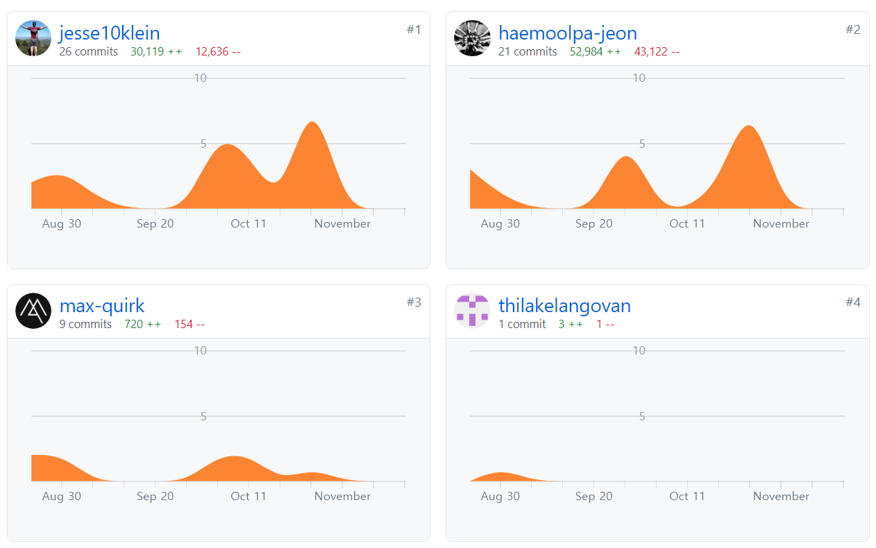
Git

Slide 8
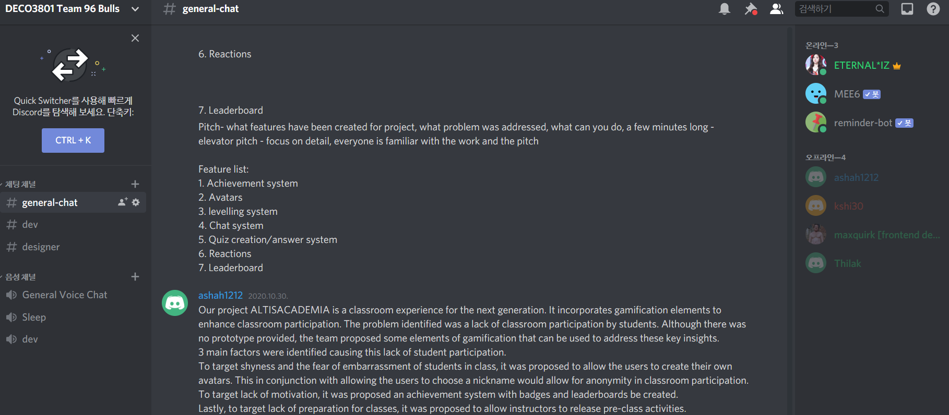
discord

Slide 9
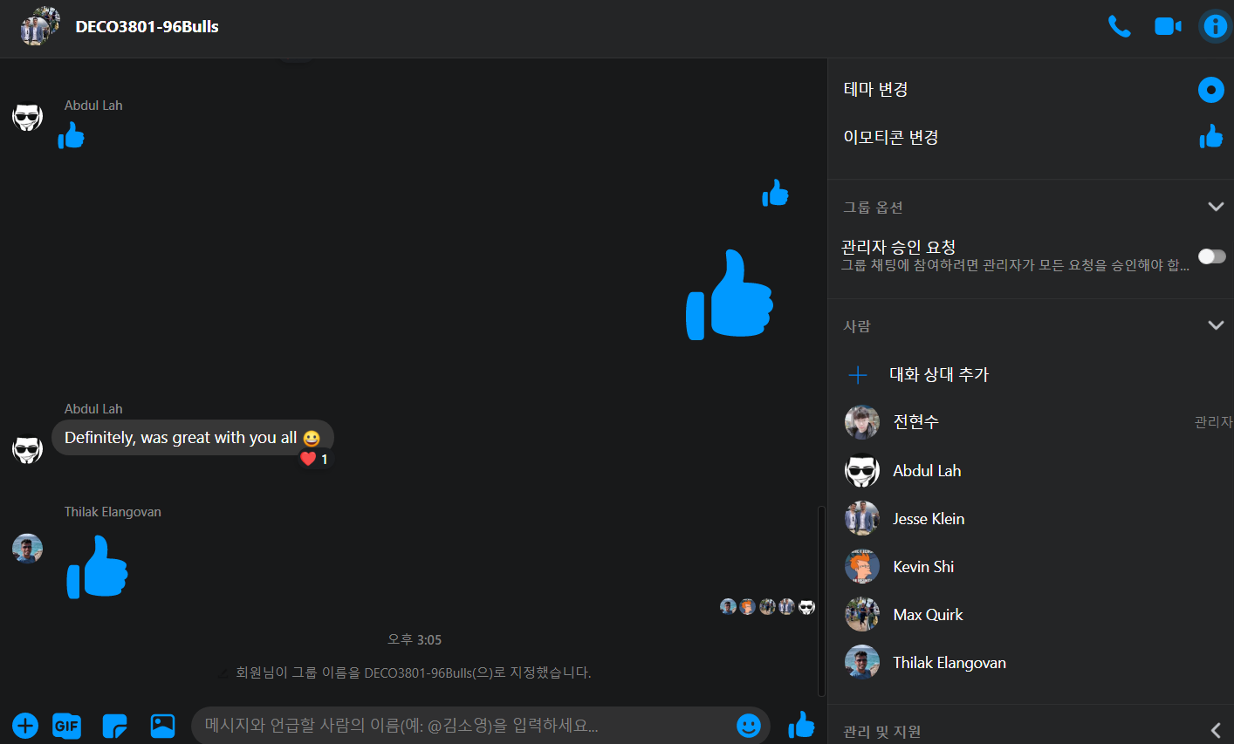
Facebook Chat

Slide 10
Evolution of scope
Original scope
More functions such as role check in
Auto generated Quiz
Work consumed time
Team members had other contributions
As project continued, minor functions were removed as it wasn’t required
Focused on functions that are core and unique to our system
Gamification
Chat

Slide 11
Team members role change
Development | Creative
Max Quirk | Ze Shi
Hyun Jeon | Abdullah Shahzad
Jesse Klein | Thilak Elangovan
Front-end | Back-end | Creative
Max Quirk | Jesse Klein | Ze Shi
Hyun Jeon | Thilak Elangovan | Abdullah Shahzad

Slide 12
Changed ideas
Requirement of Instructor page
Originally this was not planned
From everything anonymous to partial anonymous
It is difficult for others to recognize who each other are.
When it is sometimes required for teamwork
Ranking and Chat it is required to be anonymous; rest are unnecessary
Focused on functions rather than the design
Removed minor features
Nickname change
Role check in
Background color change

Slide 13
Critical thinking
During team meeting over the zoom members had critical thinking time for the next function to be developed
When the leader mentions the topic or the function to be developed, team members freely discussed and criticized on the function

Slide 14
Professional judgement
Each member had their main role in the project
Each member had profession in their main role
After team discussion, if any decision was required it was up to the member who has professional knowledge to decide
In example if a choice was required on which type of database we should use for certain function, team meeting was conducted, discussion gets done and final choice was up to the member who has most professional knowledge on Database
However these users would have some bias from previous experience.
It was left up to team member’s conscience to not bring their previous experience
Tell previous experiences during discussion
Always consie opposite opinion

Slide 15
Ethical issue
Most important ethical issue would be security and anonymous
Since instructors can see user’s name regardless of their anonymous name shown to other students, instructors should keep it to themselves
System should be secure from any breach and anonymous status should always be kept

Slide 16
What Could been done differently
If the team was given more time
Design of our system would be much more refurbished
Quizzes will be generated randomly and generates values randomly
Users can retake the quiz
Better coordination with user status and other functions
Change of nickname
Personal Colors

